Slide 1

TAX 101
SIN
TD1
Statement of Earnings
Personal Budget

Slide 2

Get a SIN…
Question: What is a SIN?
You must apply for a SIN to work in Canada or have access to government programs and benefits.
When you start a new job you must provide your SIN (social insurance number) to your employer.
Overview:
The Social Insurance Number (SIN) is a 9 digit number that you need to work in Canada or to have access to government programs and benefits.
A SIN is issued to one person only and it cannot legally be used by anyone else. You are responsible for protecting your SIN. Store any document containing your SIN and personal information in a safe place—do not keep your SIN with you.
Activity: Prepare a presentation on protecting your Social Insurance Number.
https://www.canada.ca/en/employment-social-development/services/sin.html

Slide 3
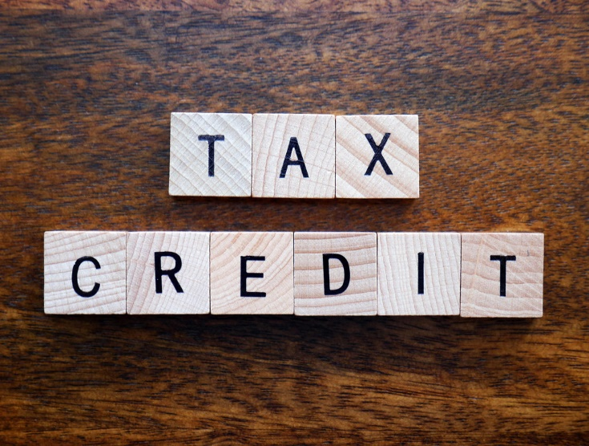
Complete Form TD1:
Personal Tax Credits Return:
You must complete Form TD1 when you start a new job.
Your employer uses the information from your completed form to determine how much tax they must deduct from your pay.
TD1 Example: Click here
TD1 Fillable Example: Click here

Slide 4
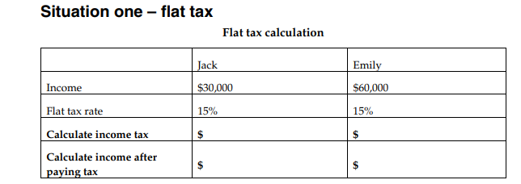

How tax affects your income:
Jack has an income of $30,000 and Emily has an income of $60,000.
Calculate Jack and Emily’s income tax in each of the following situations. Click here for answer key

Slide 5
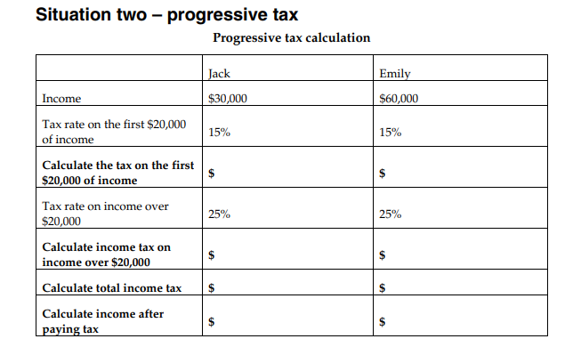
How tax affects your income:
Jack has an income of $30,000 and Emily has an income of $60,000. Click here for answer key

Slide 6
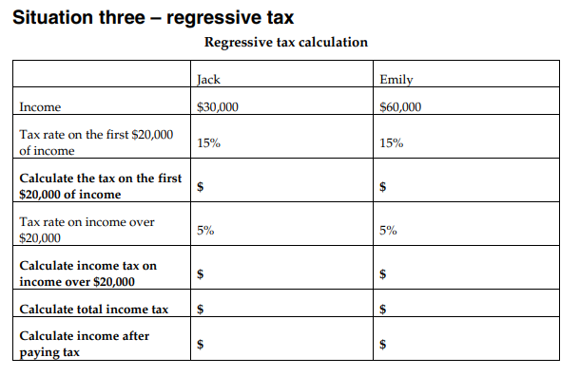
How tax affects your income:
Jack has an income of $30,000 and Emily has an income of $60,000. Click here for answer key.

Slide 7
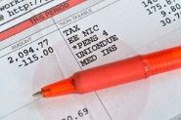
Statement of Earnings (Pay Stub)
When you are paid, your statement of earnings shows the deductions from your pay. Your employer has to deduct amounts for:
Canada Pension Plan (CPP) or Quebec Pension Plan (QPP)
Employment Insurance (EI)
Income Tax
If you live in Quebec, your employer will also deduct QPIP – Quebec Parental Insurance Plan
Discussion Activity:
When you received your first pay, did you notice if any amounts were deducted?
Did you know what those deductions were for?
How do you think the deductions were calculated?

Slide 8
Statement of Earnings (Pay Stub)
Statement of Earnings Example: Click here (Search “Canada Revenue Agency, Sample Pay Stub” if link is broken)
Discussion:
What is the meaning of gross pay versus net pay?
Gross Pay
Net Pay

Slide 9
Doing your Taxes:
To receive benefit and credits to which you’re entitled to, you need to:
File your income tax and benefit return
Keep your personal information up to date with the Canada Revenue Agency (CRA)
Check Deadline – April 30th (extension given during Co-VID)
Gather your tax information
Get everything you need to calculate your income and support any credits, deductions and expenses you’ll claim.
If you were employed or had an investment income in the previous year, your employer or financial institution will send you statements commonly referred to as ‘’slips’’. Here are some common examples:
T3 Statement of Trust Income Allocation and Designations
T4 Statement of Remuneration Paid
T5 Statement of Investment Income

Slide 10
Doing your Taxes:
Research ways to file your tax return
Use electronic software – check here – www.Canada.ca/netfile-software
On paper – Canada.ca/taxes-general-package or call CRA at 1-855-330-3305
By phone with File my Return
The Community Volunteer Income Tax Program www.Canada.ca/taxes-help
Complete your tax return
Send/Submit your tax return
By software (electronically)
If you selected a NETFILE certified software, it will communicate directly with the NETFILE application servers and transmit all required information on your behalf directly
By paper: Mail your completed income tax package to your tax centre.
By phone: Follow the instructions in the invitation letter for File my Return that you received from the CRA.

Slide 11
Doing your Taxes:
If you file online and are registered for online mail, you could get your notice of assessment (NOA) shortly after you file your tax return using the Express NOA service.
If you file your tax return online and choose direct deposit, you could receive your refund in as little as eight business days. If you send in a paper tax return, it generally takes eight weeks before the CRA issues your notice of assessment and any refund.
If taxes owed, you must pay by September 30th of the current year. If you cannot pay the balance you owe in full, you can make a payment arrangement with the CRA.
The CRA can grant relief from penalty or interest in certain circumstances.
If you forgot to include information or made a mistake on your tax return, wait until you get your Notice of Assessment from the CRA, then you can change your return.

Slide 12

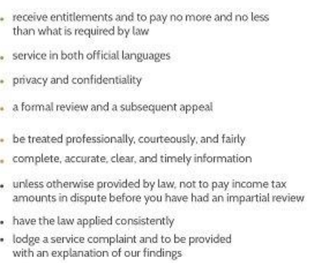
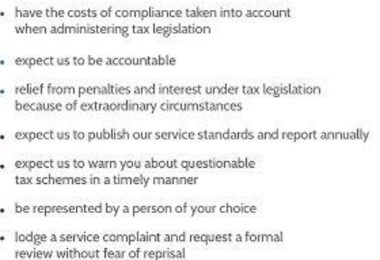
Taxpayer Bill of Rights:

Slide 13
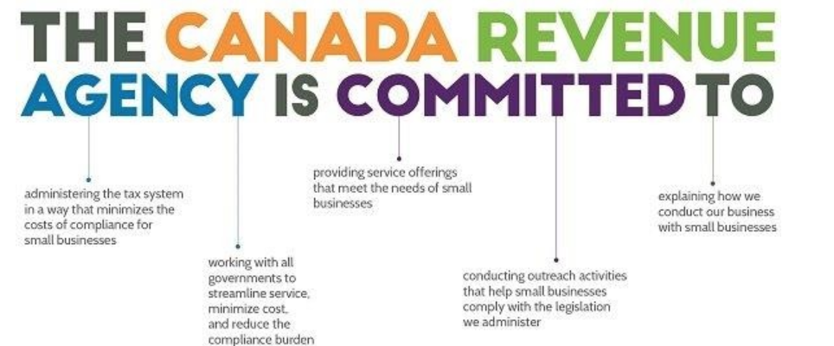
Commitment to Small Business:

Slide 14
Canada Revenue Agency is committed to:
Administering the tax system in a way that minimizes the costs of compliance for small businesses
Working with all governments to streamline service, minimize cost, and reduce the compliance burden
Providing service offerings that meet the needs of small businesses
Conducting outreach activities that help small businesses comply with the legislation we administer
Explaining how we conduct our business with small businesses

Slide 15
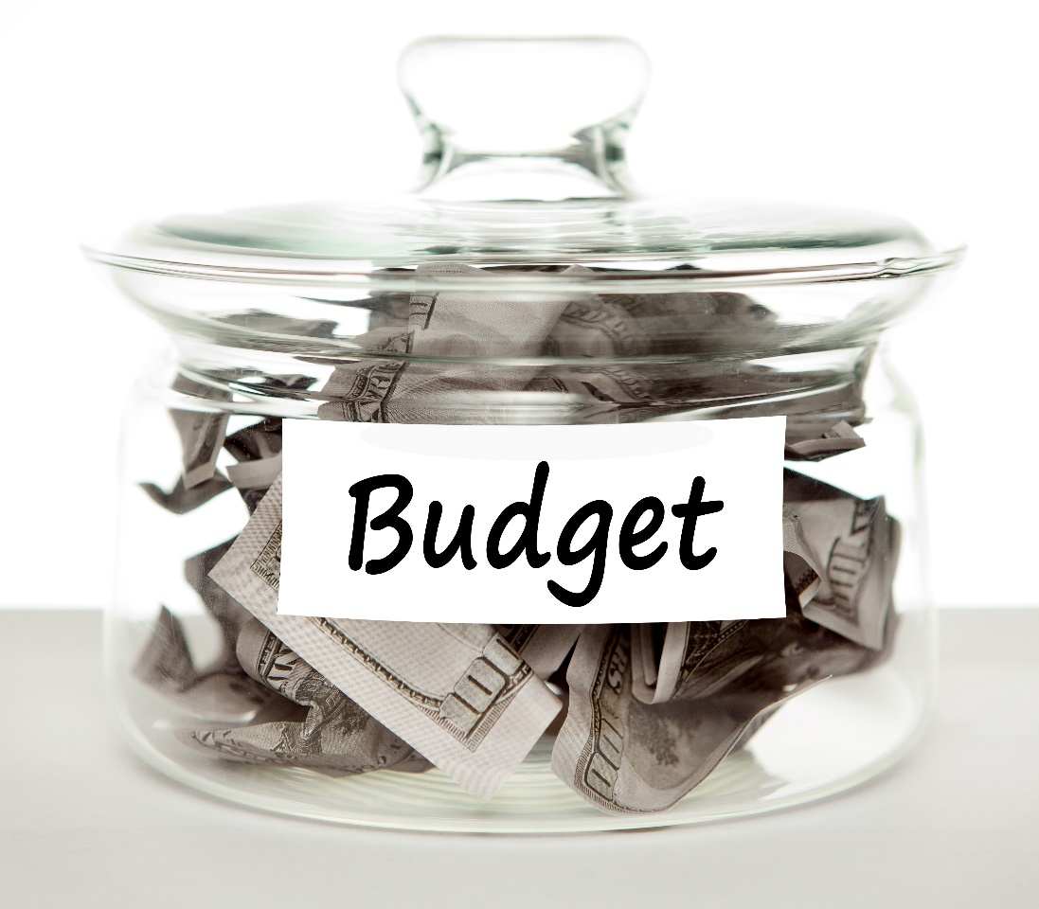
Personal Budget:
Creating a budget will:
let you know how much money you actually have to spend
help you to plan where your money goes
help you to stay out of debt
ensure you have money for the things that are important to you
help you put aside funds to start a savings plan
Activity: Go online and search for a sample budget.
Using the sample budget, complete a monthly budget for yourself.
they list where their money comes from (for example, parents, employers, odd jobs)
they list where they spend their money (for example, movies, clothes, food, leisure activities, savings)
Discussion: Reflect on your own spending habits and consider whether you will do anything differently in the future.

