Slide 1

Fundamentals of Investing
Video: https://www.canada.ca/en/financial-consumer-agency/services/financial-basics/financial-basics-videos/financial-basics-video-saving-investing.html
© 2018 McGraw-Hill Education Limited

Slide 2
Savings
Savings is the portion of current income not spent on consumption.
Investments
Investing is the purchase of assets with the goal of increasing future income.

Slide 3
In Other Words…...
Investing is what you do with your savings to try and:
protect the value of your savings over time against the effects of inflation (purchasing power).
increase value of your savings-and acquire greater purchasing power-by earning a return greater than inflation.
save enough, and earn enough, to be able to achieve your goals.

Slide 4
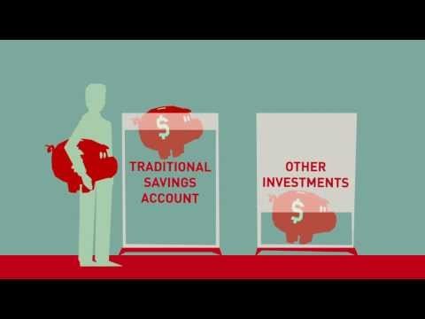

Slide 5
Preparing for an Investment Program
Establishing Investment Goals
Financial goals should be specific and measurable and tailored to your particular financial needs. Ask yourself:
  What will you use the money for & how much will you need?
  How will you and how long till you obtain the money?
  How much risk are you willing to assume?
  Are goals reasonable and are you willing to sacrifice current consumption to invest?
  What possible economic & personal conditions could alter your investment goals?
  What will happen if you don’t reach your goals?
  Considering your economic circumstances, are your investment goals reasonable
© 2018 McGraw-Hill Education Limited

Slide 6
Preparing for an Investment Program
Performing a Financial Checkup
Live within your means
  Reduce high interest debt first
Obtain adequate insurance protection
Start an emergency fund you can access quickly
  Three to nine months of living expenses
Have access to other sources of cash for emergencies
  Line of credit is a short-term loan approved before the money is needed
  Cash advance on your credit card
© 2018 McGraw-Hill Education Limited

Slide 7
Preparing for an Investment Program
Getting the Money Needed to Start an Investing Program
Prioritize your investment goals. How badly do you want to achieve them?
  Pay yourself first
  Participate in elective savings programs
    Payroll deduction or electronic transfer
  Make extra effort to save one - two months/year
  Take advantage of employer-sponsored retirement programs
  Take advantage of gifts, inheritances, and windfalls
© 2018 McGraw-Hill Education Limited

Slide 8
Preparing for an Investment Program
How Time Value of Money Leads to Long-Term Investment Services
Many people don’t start investing because they only have a small amount to invest
but...
Small amounts invested regularly become large amounts over time.
© 2018 McGraw-Hill Education Limited

Slide 9
WHAT ARE SOME RISKS
TO INVESTING????
https://www.investopedia.com/terms/r/risk.asp

Slide 10
Risk, Return, and Liquidity
Risk
  The chance that the value of an investment will decrease.
Return
  The profit or yield from an investment.
Liquidity
  The ability of an investment to be converted into cash quickly without loss of value.

Slide 11
Risk, Return, and Liquidity
Savings
  Low risk
  Low return
  High liquidity
Investments
  High risk
  High return
  Low liquidity

Slide 12

Inflation, Savings and Investments
Today, a large soft drink at your favorite fast-food place costs $1.00. You buy the soft drink but also decide to save some money for the future as well. So you put a dollar in your savings account, where it earns 5%.
NEFE

Slide 13
Inflation, Savings and Investments
One year later, the dollar in your saving account is worth $1.05. You take the money out and visit your favorite convenience store, hoping to buy another delicious beverage. Unfortunately, drinks now cost $1.10.
NEFE

Slide 14

Inflation, Savings and Investments
The point? Inflation can work against your money. You need to learn to invest wisely, follow the rate of inflation, and make sure your investment rates are higher than those of inflation.

Slide 15
Time Value of Money
The time value of money refers to the fact that a dollar in hand today is worth more than a dollar promised at some future time.

Slide 16
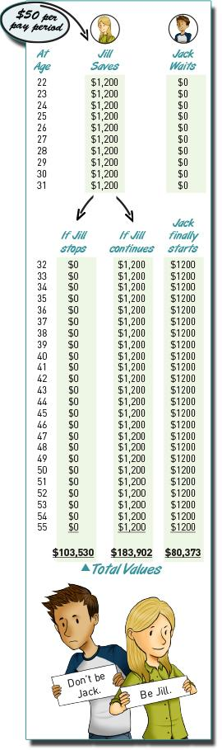

Slide 17

Future Value
Refers to the amount of money to which an investment will grow over a finite period of time at a given interest rate.
Put another way, future value is the cash value of an investment at a particular time in the future.

Slide 18

“You can always make more money, but you can’t make more time.”

Slide 19
Risk and Return- What is the relationship between risk and return?
Savings
  Low risk
  Low return
  High liquidity
Investments
  High risk
  High return
  Low liquidity

Slide 20
TYPES OF INVESTMENTS
Source: https://drive.google.com/file/d/18xjeb3mnLRkxt7E5YwGMwgsSnMehQO7D/view?usp=sharing

Slide 21
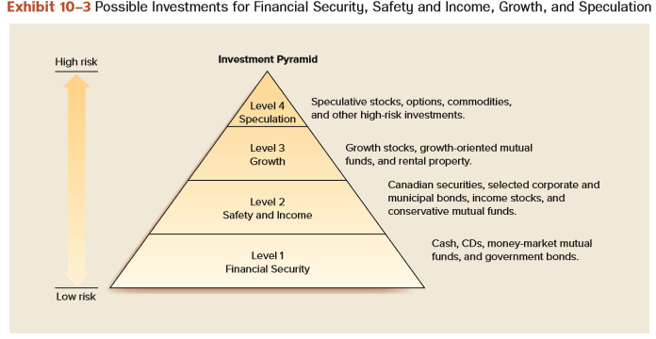
An Overview of Investment Alternatives
© 2018 McGraw-Hill Education Limited

Slide 22
Factors Affecting the Choice of Investments
Investment Safety and Risk
Safest investments include:
  Savings accounts
  Government Savings bonds
  Canadian Treasury Bills
  Guaranteed Investment Certificates (GICs)
  Term deposits
  Certain negotiable government and corporate bonds
© 2018 McGraw-Hill Education Limited

Slide 23
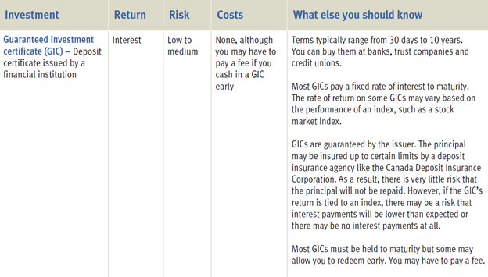
CASH TYPE INVESTMENTS (high liquidity)

Slide 24
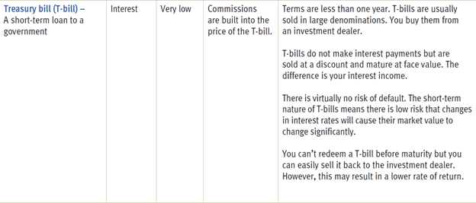
CASH TYPE INVESTMENTS (high liquidity)

Slide 25
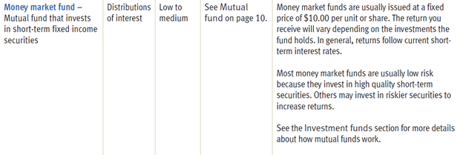
CASH TYPE INVESTMENTS (high liquidity)

Slide 26
An Overview of Investment Alternatives
Corporate and Government Bonds
A bond is a loan to a corporation, the federal government, or a municipality
Bondholders receive periodic interest payments, and the principal they lent is repaid at maturity (1-30 years)
Bondholders can keep the bond until maturity or sell it to another investor
© 2018 McGraw-Hill Education Limited

Slide 27
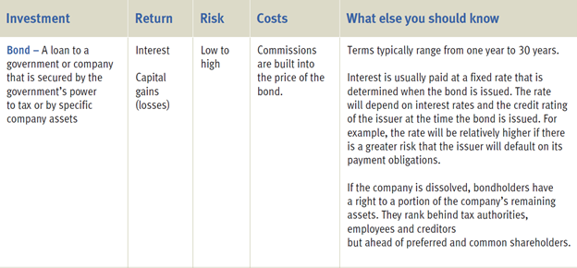
FIXED INCOME (Investments with regular interest payments to you)

Slide 28
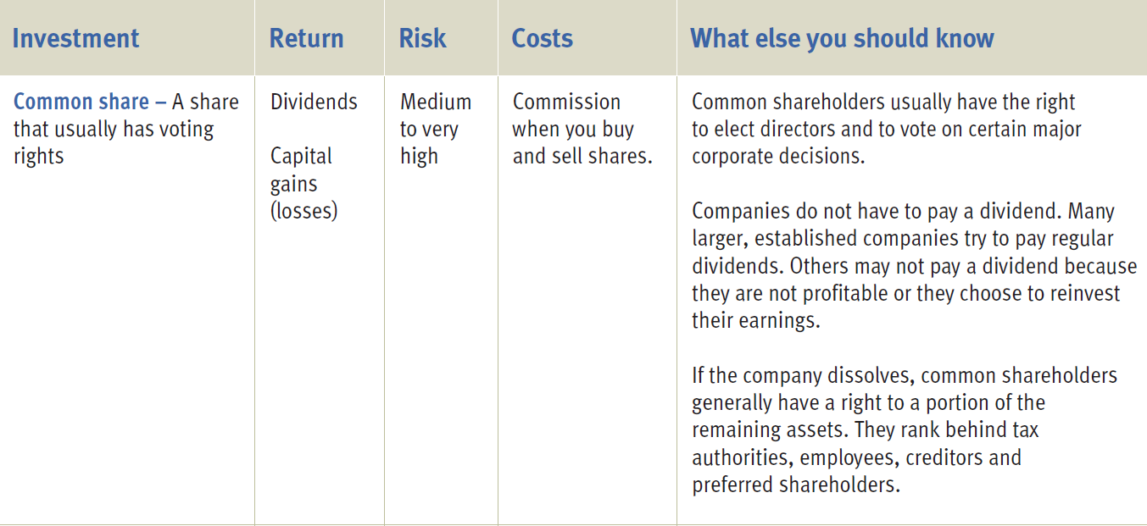
EQUITIES

Slide 29
WHAT IS A STOCK MARKET?
A stock market is a market for the trading of company stock (shares) at an agreed price.
In 2020, stock markets in the United States accounted for over 54 percent of world stocks. The next largest country by stock market share was Japan, followed by the United Kingdom. The New York Stock Exchange (NYSE) and the NASDAQ are the largest stock exchange operators worldwide.

Slide 30
An Overview of Investment Alternatives
Stock of Equity Financing- Video: What is a stock? https://youtu.be/JrGp4ofULzQ
Equity capital is provided by stockholders, who buy shares of a company’s stock
Stockholders are owners and share in the success of the company. Stocks are an attractive investment because the possible return is higher than offered by other financial investments like saving accounts
Shareholders share in the success of the corporation making it an attractive investment opportunity
© 2018 McGraw-Hill Education Limited

Slide 31
HOW DO I MAKE MONEY ON SHARES?
  1. Dividend – a distribution of money, stocks, or other property that a corporation pays to shareholders
  2. Gain on Stock Price- sell it for more than you paid
The shares of a company are in general be transferable from one shareholder to another . This leads to buying and selling of shares termed as trading. At any given moment, the price is strictly a result of supply and demand. The supply is the number of shares offered for sale at any one moment. The demand is the number of shares investors wish to buy at exactly that same time.

Slide 32
STOCK PRICES FLUCTUATE...
Blackberry partners with Samsung to provide heightened security. Many people believe this will turn Blackberry’s luck around and lead to improved profits. Does their share price go up or down?

Slide 33

Stock markets and the financial risk
Sometimes the market seems to react irrationally to economic or financial news. This may 'temporarily' move financial prices away from their long term aggregate price 'trends'.
Bull Market : Positive or upward trends
Bear Market: negative or downward trends

Slide 34
Stock Market Crashes
A stock market crash is often defined as a sharp dip in share prices of equities listed on the stock exchanges. In parallel with various economic factors, a reason for stock market crashes is also due to panic and investing public's loss of confidence. Often, stock market crashes burst speculative economic bubbles.
Famous stock market crashes have lead to the loss of billions of dollars and wealth destruction on a massive scale.

Slide 35
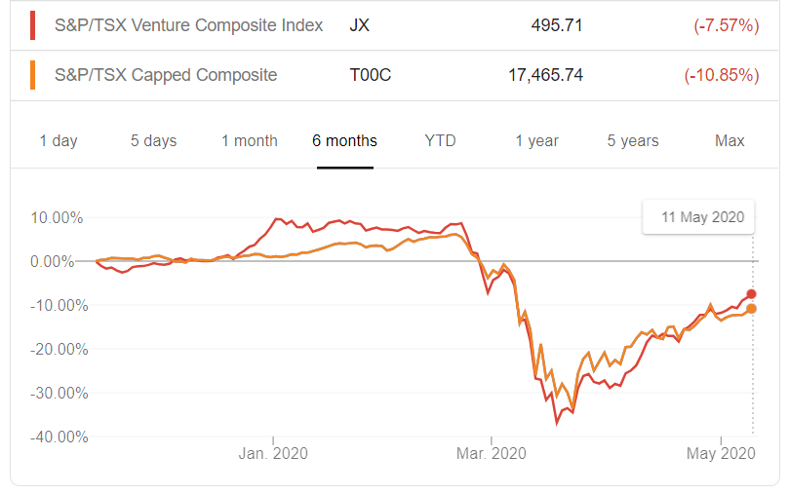
STOCK MARKET CANADA

Slide 36
“Bulls make money, Bears make money, Pigs get slaughtered”
                Gordon Gekko
Warren Buffett: Be Greedy Whn Others are Fearful, Be Fearful When Others Are Greedy

Slide 37
An Overview of Investment Alternatives
Mutual funds:
  Investors’ money is pooled and invested by a professional fund manager
  You buy shares in the fund
  Provides diversification to reduce risk
  Funds range from conservative to extremely speculative
  Match your needs with a fund’s objective
© 2018 McGraw-Hill Education Limited

Slide 38
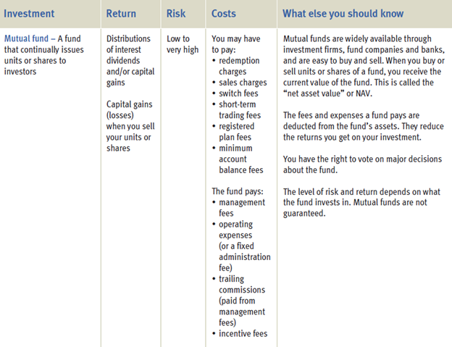
MUTUAL FUNDS

Slide 39
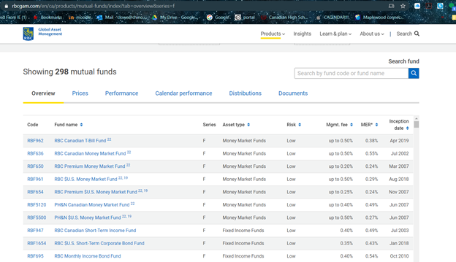
TYPES OF MUTUAL FUNDS
https://www.rbcgam.com/en/ca/products/mutual-funds/index?tab=overview&series=f

Slide 40
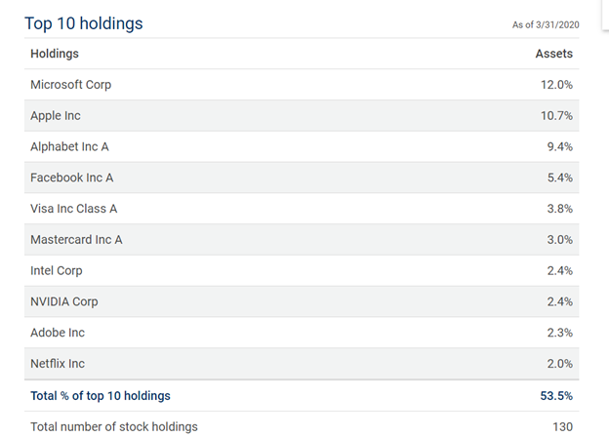
RBC GLOBAL TECHNOLOGY FUND https://drive.google.com/open?id=15KtJXAnix6NGmFzB5vAw3UVdBE2Zb8vg
https://www.rbcgam.com/en/ca/products/mutual-funds/RBF620/detail

Slide 41
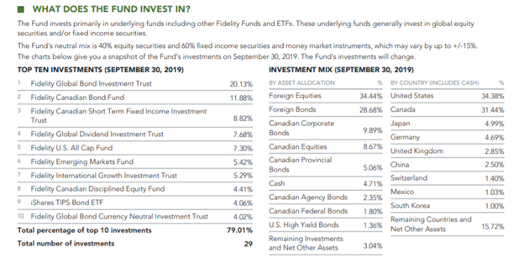
FIDELITY GLOBAL INCOME FUND https://www.fidelity.ca/fidca/en/products/gin

Slide 42
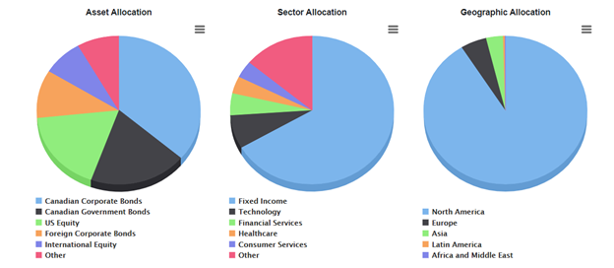
LESS RISK? MORE INCOME FUND?
TD Managed Income Portfolio H5 Series http://gm.fundataapi.com/Get.aspx?GUID=212596DB-1201-44BB-AE5C-7D0A70416727

Slide 43
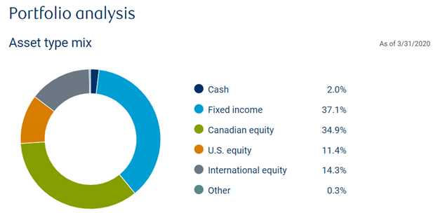
WHAT IS A BALANCED FUND?? https://www.rbcgam.com/en/ca/products/mutual-funds/RBF604/detail

Slide 44
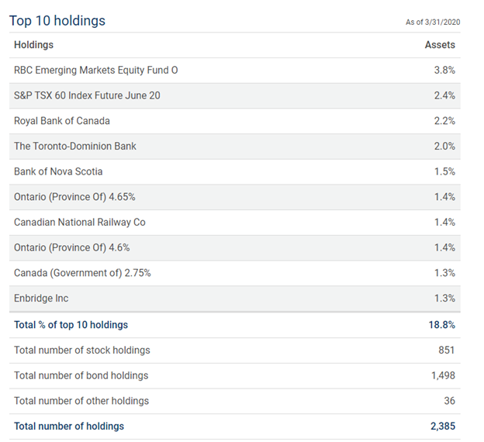
WHAT IS A BALANCED FUND??

Slide 45
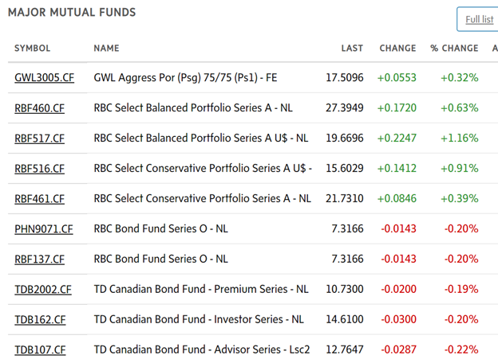
Which funds do you pick?
https://www.theglobeandmail.com/investing/markets/funds/

Slide 46
An Overview of Investment Alternatives
© 2018 McGraw-Hill Education Limited

Slide 47
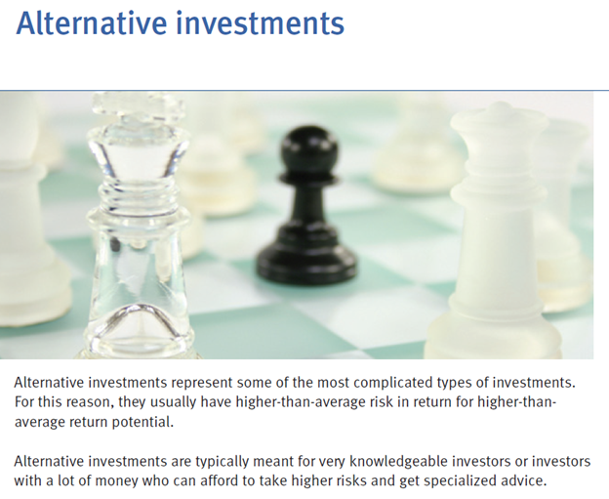

Slide 48
An Overview of Investment Alternatives
Real Estate
Buy property and sell it when it increases in value
Location, location, location is important
Before you buy property, consider:
  Is the property priced competitively?
  What type of financing is available, if any?
  How much are the taxes?
  What is the condition of nearby buildings/houses?
  Why are the present owners selling?
  Could the property decrease in value?
  How will I maintain and care for the property?
  Can I afford the mortgage payments if interest rates go up?
© 2018 McGraw-Hill Education Limited

Slide 49
An Overview of Investment Alternatives
Other Investment Alternatives
A speculative investment is a high-risk investment made in the hope of earning a relatively large profit in a short time
Typical speculative investments include:
  Antiques and collectibles
  Commodities
  Coins and stamps
  Precious metals and gemstones
  Antiques and collectibles
© 2018 McGraw-Hill Education Limited

Slide 50
HOW DO I MAKE MONEY????

Slide 51
Factors Affecting the Choice of Investments
Investment Income
Purchase certain investments because you want a predictable source of income
  GIC’s, Savings Bonds, and Treasury Bills
Other sources of investment income are not as predictable
  Mutual funds, real estate rental property
  Speculative investments such as precious metals, gems, and collectibles offer little potential for regular income
© 2018 McGraw-Hill Education Limited

Slide 52
Factors Affecting the Choice of Investments
Investment Growth
Investments will increase in value
  Common stock
  Growth stocks reinvest retained earnings
  Bonds, mutual funds, and real estate
Investment Liquidity
Ability to buy or sell an investment quickly without substantially affecting the investment’s value
© 2018 McGraw-Hill Education Limited

Slide 53
Factors That Affect Investment Choices
Diversification
  Spreading your assets among several types of investments to lessen risk
A Personal Investment Plan
  Establish goals and determine the amount of money needed to obtain them
  Evaluate risk and potential return on different investments
  After choosing your investments continue to evaluate your program
© 2018 McGraw-Hill Education Limited

Slide 54
Factors Affecting the Choice of Investments
Safety and Risk
  The potential return on any investment should be directly related to the risk the investor assumes
Safety in an investment means minimal risk of loss
  Potential return on any investment should be directly related to the risk the investor assumes
Risk tolerance is the amount of psychological pain you’re willing to suffer for your investments
Risk associated with investing:
  You could lose all or part of your principal
  The purchasing power of your investment can decrease
  You may not receive the return you expected
© 2018 McGraw-Hill Education Limited

Slide 55
WHAT ARE SOME RISKS
TO INVESTING????
https://www.investopedia.com/terms/r/risk.asp

Slide 56
Factors Affecting the Choice of Investments
Components of the risk factor can include:
Business Failure Risk https://www.bnnbloomberg.ca/businessweek/private-equity-won-big-on-lululemon-and-it-s-not-done-yet-1.1361557
  Business will be less profitable than anticipated
  What are some business risks? https://www.investopedia.com/ask/answers/042415/what-are-different-sources-business-risk.asp
  ENRON
  WORLDCOM
  NORTEL
  BRE-X
  SEARS
  TOYS R US
© 2018 McGraw-Hill Education Limited

Slide 57
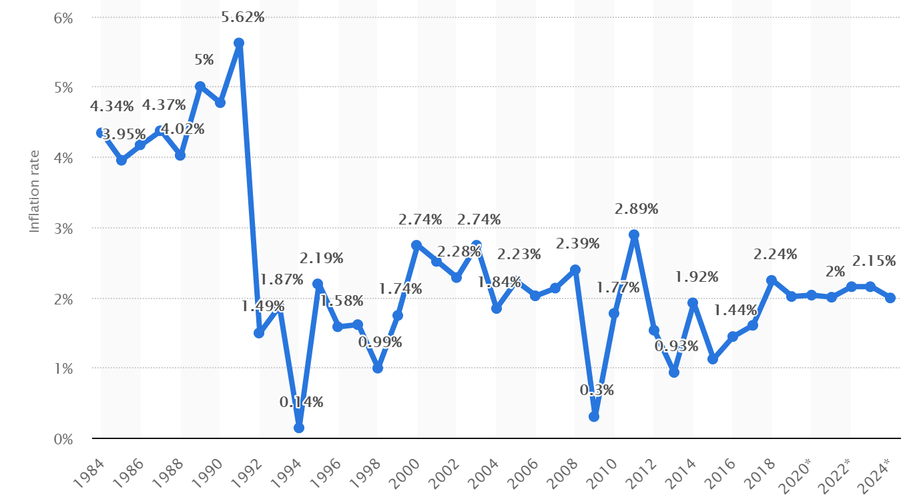
Components of the risk factor can include:
Inflation Risk https://www.bnnbloomberg.ca/canadian-inflation-holds-steady-at-1-9-core-measures-accelerate-1.1350855
  Return on investment will not keep up with inflation https://www.bankofcanada.ca/rates/related/inflation-calculator/
© 2018 McGraw-Hill Education Limited

Slide 58
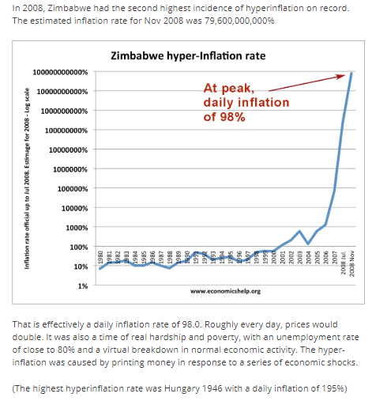
Factors Affecting the Choice of Investments
Components of the risk factor can include:
Inflation Risk
https://www.economicshelp.org/blog/390/inflation/hyper-inflation-in-zimbabwe/
Causes of hyper-inflation in Zimbabwe
Government printing money in response to:
High national debt
Decline in economic output.
Decline in export earnings.
Price controls which exacerbate shortages.
Lack of confidence in government, economy and political life.
Expectations of hyperinflation
© 2018 McGraw-Hill Education Limited

Slide 59
Factors Affecting the Choice of Investments
Components of the risk factor can include:
Interest Rate Risk
  Changes in the interest rates in the economy
  https://corporatefinanceinstitute.com/resources/knowledge/finance/interest-rate-risk/
  VIDEO https://www.investopedia.com/articles/optioninvestor/08/manage-interest-rate-risk.asp
© 2018 McGraw-Hill Education Limited

Slide 60
Factors Affecting the Choice of Investments
Components of the risk factor can include:
Market Risk & Global Investment Risk
  Should be evaluated like domestic investments
Biggest political risks in 2019 https://www.bnnbloomberg.ca/the-biggest-political-risks-to-the-world-economy-in-2019-1.1178410
  Values fluctuate because of behavior of investors in marketplace
© 2018 McGraw-Hill Education Limited

Slide 61
Canada’s economy faces two significant shocks—the plunge in global oil prices and the impact of the COVID-19 pandemic.
April 2020
What you need to know about the Bank of Canada’s assessment of the Canadian economy in the face of COVID-19, and how we’re responding. https://youtu.be/p99SVnKg04Y
BDC MONTHLY ECONOMIC LETTER https://www.bdc.ca/en/articles-tools/entrepreneur-toolkit/publications/monthly-economic-letter/pages/2004.aspx

Slide 62
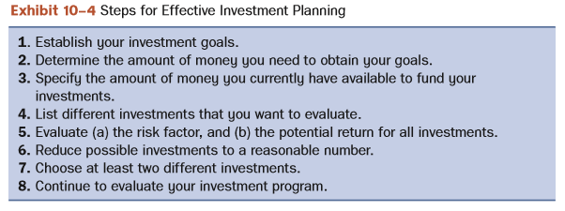
An Overview of Investment Alternatives
© 2018 McGraw-Hill Education Limited

Slide 63
Factors That Reduce Investment Risk
The Role of a Financial Planner
Seek professional help from stockbrokers, lawyers, accountants, bankers, and insurance agents or Chartered Financial Planners
  Be aware of how they are paid and how this influences the advice they give
© 2018 McGraw-Hill Education Limited

Slide 64
Factors That Reduce Investment Risk
Your Role in the Investment Process
Evaluate potential investments.
Monitor the value of your investments.
Keep accurate and current records.
Be aware of tax considerations, including tax deferred and tax exempt investments.
Keep track of capital gains and losses, interest income, rental income, and dividends.
  Check to see if you qualify for a capital gains exemption
© 2018 McGraw-Hill Education Limited

Slide 65
Sources of Investment Information
The Internet and online services:
  Use a Internet search engine to find information
  View sites such as Canoe Money, The Balance, Globe Investor, Investopedia
Online Newspapers and news programs
Business periodicals and government publications
Corporate Reports
Statistical Averages
Investor Services and newsletters
Desktop and Mobile Information Services
© 2018 McGraw-Hill Education Limited

Slide 66
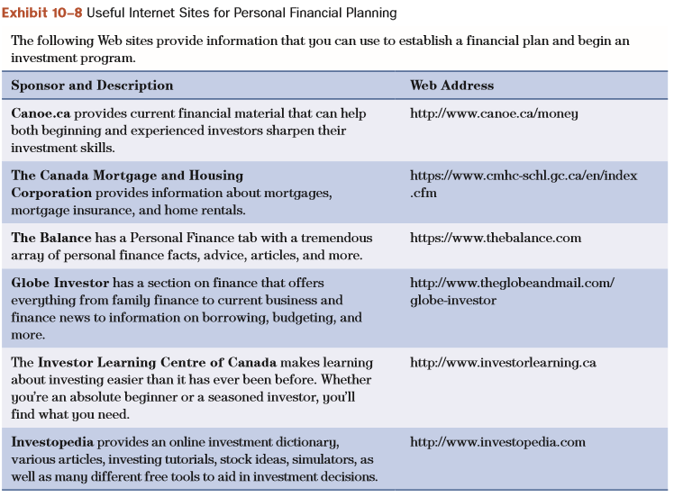
Sources of Investment Information
© 2018 McGraw-Hill Education Limited

Slide 67
Summary
Explain why you should establish an investment program
  Goals should be specific and measurable
  Classified as short-term, intermediate, and long-term
  Be sure personal financial affairs are in order
    Learn to live within your means
    Obtain adequate insurance protection
  Accumulate emergency fund (3−9 months living expenses)
  Then it is time to save and invest your money
© 2018 McGraw-Hill Education Limited

Slide 68
Summary
Describe how safety, risk, income, growth, and liquidity affect your investment decisions
  Especially important is relationship between safety and risk
  Potential return for any investment should be directly related to the risk an investor assumes
  Five components of the risk factor:
    Inflation risk, Interest rate risk, Business risk, Market risk, Global investment risk
© 2018 McGraw-Hill Education Limited

Slide 69
Summary
Identify the major types of investment alternatives
  Stocks, Bonds, Mutual Funds, Real Estate
  Speculative investments include options, derivatives, commodities, precious metals, gemstones and collectibles
  Evaluate based on safety, risk, income, growth, and liquidity
  Diversify to lessen risk
  Develop a specific, personal investment plan
© 2018 McGraw-Hill Education Limited

Slide 70
Summary
Recognize the role of the professional financial planner in a personal investment program
  Use reputable associations with regulated designations
  List formal training as well as minimum of experience and commitment
  Can help you achieve your investment goals
  Choosing a qualified planner is your responsibility
    Monitor the value of your investments
    Keep accurate and current records
© 2018 McGraw-Hill Education Limited

Slide 71
Summary
Use various sources of financial information that can reduce risks and increase investment return
  Be selective in the type of information you use
  Internet
  Newspapers and new programs
  Business periodicals
  Government publications
  Corporate reports
  Statistical averages and investor services
© 2018 McGraw-Hill Education Limited

