Slide 2
INTRODUCTION
SECTION 1:

Slide 3
WHAT YOU WILL LEARN TODAY
What are credit reports and credit scores
What information is included in a credit report
How lenders use credit reports and credit scores
Why you should check your credit report every year
How to order your credit report and credit score

Slide 4

CREDIT REPORTS CAN INCLUDE
(more than one answer may be correct)
  Your credit cards and loans
  Your mobile phone account
  Your Facebook posts
  Your mortgage
  All of the above

Slide 5

ANSWER
  a. Your credit cards and loans
  Your mobile phone account
  d. Your mortgage

Slide 6

TRUE OR FALSE?
When it comes to credit scores,
the lower the number, the better.

Slide 7

ANSWER
FALSE:
The higher the credit score, the better.

Slide 8

MISSED PAYMENTS GENERALLY STAY ON YOUR CREDIT REPORT
  For 1 year
  For up to 6 years
  Forever
  Only as long as you want them to

Slide 9

ANSWER
  b. For up to 6 years

Slide 10

TRUE OR FALSE?
To build a credit history, you should apply for every type of credit card you can get your hands on.

Slide 11
ANSWER
FALSE:
To build a credit history, you need to use different types
of credit over time.
However, you shouldn't apply for too many sources of credit within a short period of time.

Slide 12

TRUE OR FALSE?
You have to pay to order your credit report from a credit bureau.

Slide 13
ANSWER
TRUE AND FALSE:
You don't have to pay when you order your credit report
by mail or phone. If you order your credit report using one
of these methods, you'll get it by mail.
You do have to pay to get your credit report instantly online, and you usually have to pay to get your credit score.

Slide 14
^{Credit Report and}
^{Credit scorE basics}
SECTION 2:

Slide 15
WHAT IS A CREDIT REPORT?
Summary of your credit history
Compiled by Canada’s credit bureaus:
  – Equifax
  – TransUnion
Based on information submitted by lenders and other companies, such as banks, credit card companies and telecommunications companies

Slide 16

WHAT’S INCLUDED IN YOUR
CREDIT REPORT?
When you opened each account
How much you owe
Whether you make payments on time
Whether you miss payments
Whether you go over your credit limit

Slide 17

WHAT IS A CREDIT SCORE?
A number showing how well you
use credit
Scale from 300 to 900 points
Ratings range from poor to excellent, or very poor to very good
Best score is 900

Slide 18
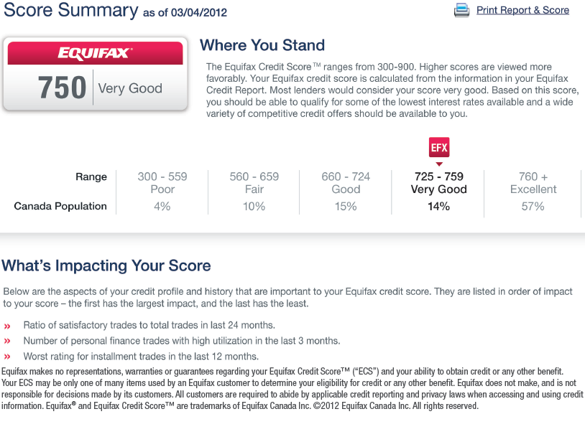
SAMPLE CREDIT SCORE – EQUIFAX

Slide 19
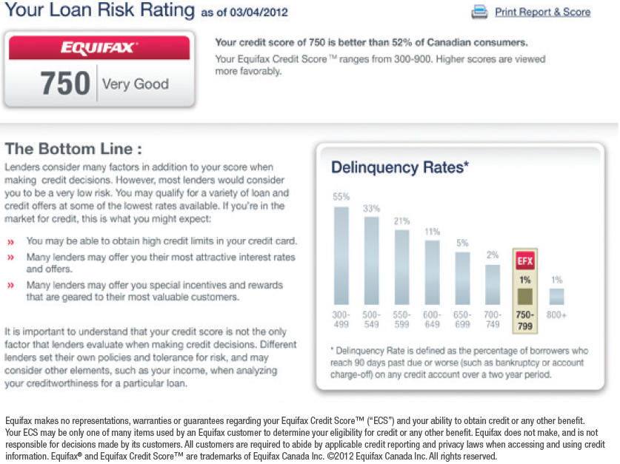
SAMPLE CREDIT SCORE – EQUIFAX

Slide 20
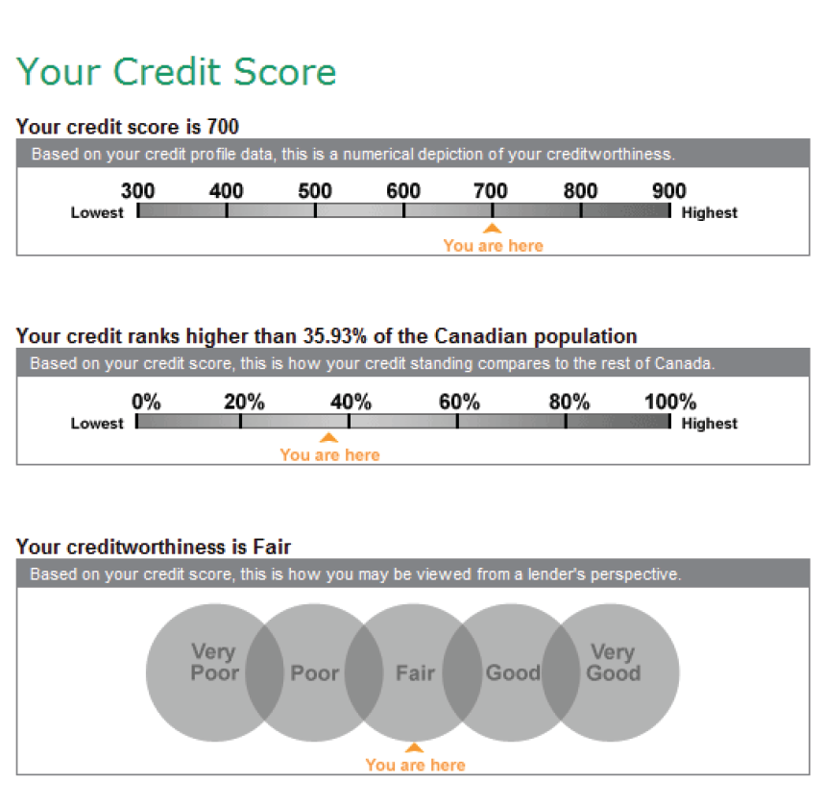
SAMPLE CREDIT SCORE – TRANSUNION

Slide 21
HOW ARE YOUR CREDIT REPORT
AND CREDIT SCORE USED?
Determine if you are a high or low risk for credit
Set the interest rate you will be charged
Set your credit limit
Consider you for rental housing or a job
How much you pay for insurance (in some provinces)

Slide 22

PART 1: PERSONAL INFORMATION
Name
Address
Phone numbers
Date of birth
Social Insurance Number
Employment

Slide 23
PART 2: CREDIT HISTORY
Credit accounts and transactions
Mobile phone accounts
Negative banking information
Public records and registered items
Debts sent to collection agencies
Credit checks by lenders
Statements and alerts

Slide 24
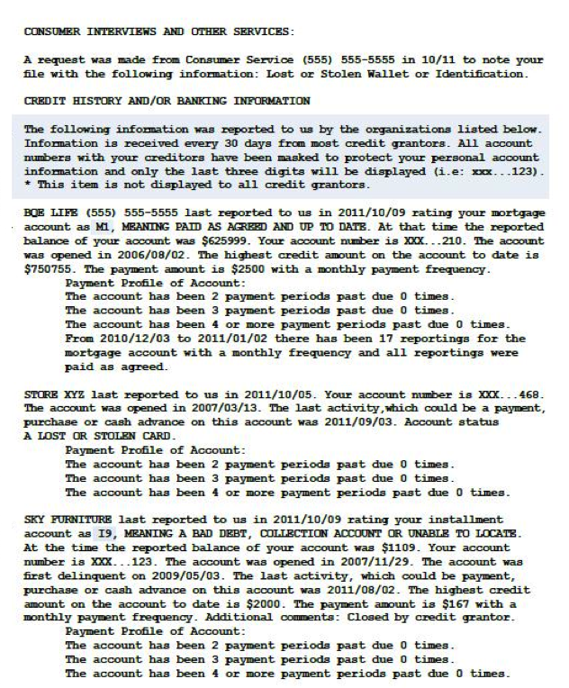
SAMPLE CREDIT HISTORY - EQUIFAX

Slide 25
HOW LONG DOES INFORMATION STAY ON YOUR CREDIT REPORT?
Varies according to type of information, province
or territory and credit bureau
Examples:
  Negative information about credit cards and loans:
  6 years
  Credit checks by lenders: Equifax – 3 years;
  TransUnion – 6 years
  Bankruptcy: 6 or 7 years

Slide 26

CALCULATING YOUR CREDIT SCORE
Payment history
Use of available credit
Length of credit history
Number of credit checks
Types of credit

Slide 27

PAYMENT HISTORY – WHAT CAN DAMAGE YOUR CREDIT SCORE?
Late payments
Missed payments
Debts sent to a collection agency
Bankruptcy
Payments withheld because of
a dispute

Slide 28
TIPS
Always make payments on time and in full
If you can’t pay in full, make at least the minimum payment
If you can’t make the minimum payment, contact the lender right away
  Ask if you can make a special arrangement to pay off
  the debt

Slide 29


USE OF AVAILABLE CREDIT
Available credit = total of the credit limits for all your credit products
Use a large % of your available credit – Greater risk lower score
Use a lower % of your available credit
– Lower risk higher score

Slide 30

TIP
Try to use less than 35% of your
total available credit
Example:
  Credit card limit = $5,000
  Line of credit limit = $10,000
  Total available credit = $15,000
  35% of $15,000 = $5,250

Slide 31

TIP
Keep an older account open
Use it from time to time to keep
it active

Slide 32
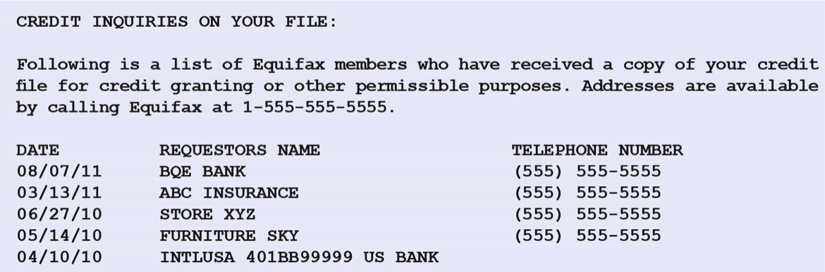
EXAMPLE OF A CREDIT CHECK

Slide 33

TIP
Limit the number of credit applications you make within
a short time
Seek credit only when you need it

Slide 34

TIP
Diversify with a variety of types
of credit — but don’t go overboard!

Slide 35
HOW TO IMPROVE YOUR CREDIT SCORE
Make payments on time and in full
If you can’t pay in full, make at least the minimum payment
If you can’t make the minimum payment, contact the lender right away
Try to use no more than 35% of total available credit
Keep an older account open to help maintain a long-term credit history
Don’t over-apply. Seek credit only when you really need it
Diversify with a mix of credit products

Slide 36
CHECKING YOUR CREDIT REPORT
SECTION 3:

Slide 37

WHAT TO LOOK FOR WHEN YOU CHECK YOUR CREDIT REPORT
Mistakes in your personal information
Errors in credit card and loan accounts
Negative information listed for
too long
Accounts you didn’t open

Slide 38
HOW TO CORRECT ERRORS
IN YOUR CREDIT REPORT
Dispute incorrect information
Correct errors to avoid negative consequences
Follow the credit bureaus’ procedures
If needed, add a consumer statement or fraud alert

Slide 39
EXAMPLE OF A FRAUD ALERT

Slide 40

HOW TO ORDER YOUR CREDIT REPORT AND CREDIT SCORE
Credit report by mail, telephone
and in person – free of charge
Credit report online – costs money
Credit score – usually costs money

Slide 41
CONTACT INFORMATION
Equifax
1-800-465-7166
www.equifax.ca
TransUnion
1-800-663-9980
www.transunion.ca

Slide 42
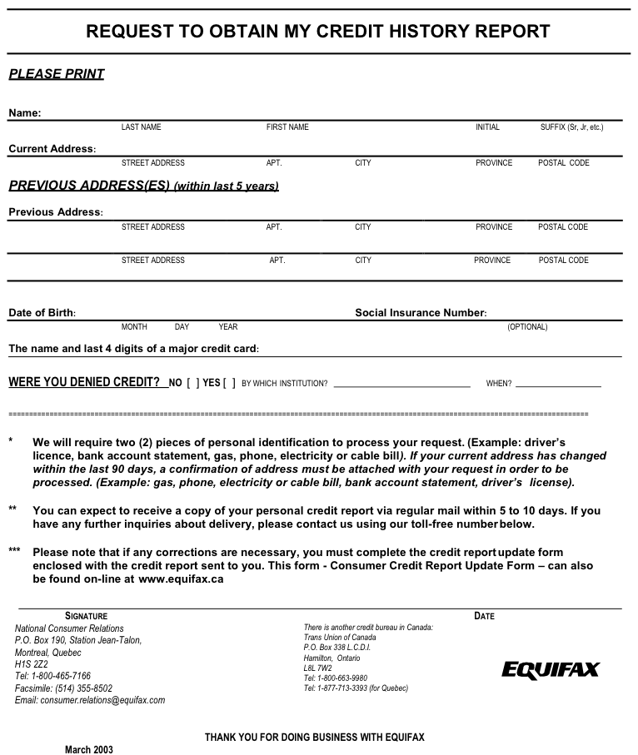
EQUIFAX APPLICATION FORM

Slide 43
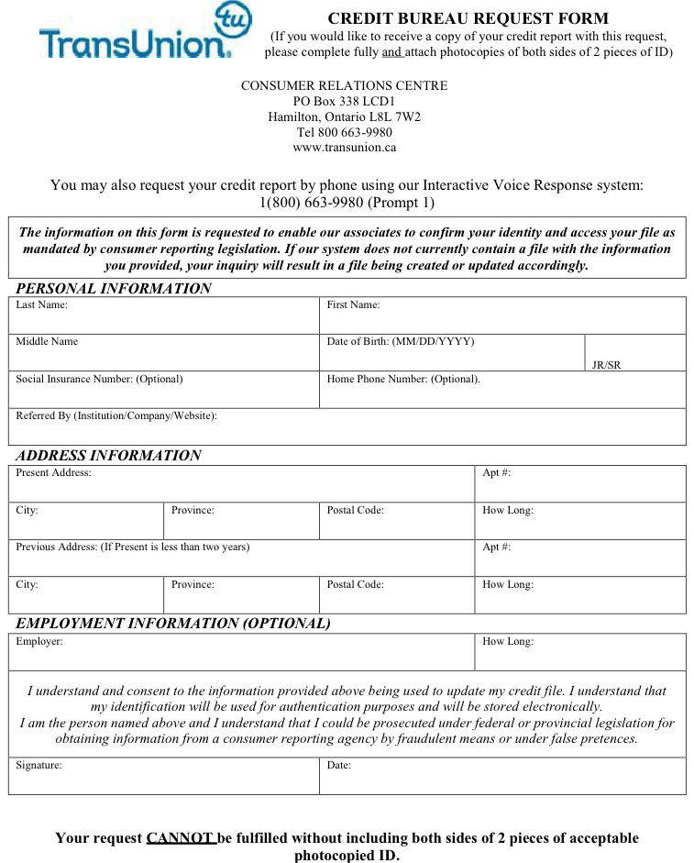
TRANSUNION APPLICATION FORM

Slide 44
SUMMARY
SECTION 4:

Slide 45
SUMMARY – PART 1
Credit report: summary of your credit history
Credit score:
  – Shows how well you use credit
  – Three-digit number between 300 and 900
Lenders use your report and score: Are you a
high or low credit risk?
Negative information: Remains on your credit report
for a fixed length of time

Slide 46
SUMMARY – PART 2
To improve your credit score:
  Make payments on time and in full
  If you can’t pay in full, make at least the minimum payment
  If you can’t make the minimum payment, contact the lender right away to make other arrangements
  Try to use no more than 35% of your total available credit
  Keep an older account open to help maintain a long-term credit history
  Don’t over-apply for credit
  Diversify with a mix of credit types

Slide 47
SUMMARY – PART 3
Check your credit report at least once a year
  Order your report from each credit bureau
Look for errors and identify fraud
Credit report:
  – Order for free by mail or telephone
  – Pay to order online
Credit score: usually pay to order online

Slide 48
Q & A
SECTION 5:

Slide 49
ACTIVITY
SECTION 6:

Slide 50
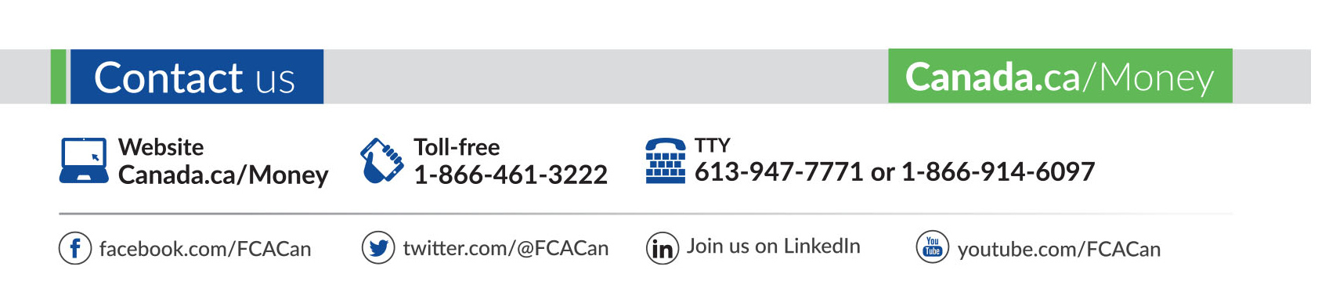
CONTACT THE FINANCIAL CONSUMER AGENCY OF CANADA

