Slide 1

CAREER OPPORTUNITIES IN THE FINANCE INDUSTRY

Slide 2
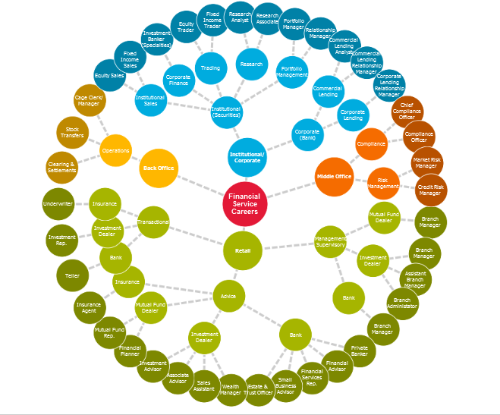


Slide 3

Career Options for a Financial Career
The financial sector in Canada is one of growth.
There are many options in the Finance Industry for a career such as:
Accountant,
Actuary,
Statistician,
Trader,
Investment Banker,
Stockbroker,
Auditor,
Economist or Financial Advisor
to name a few and the list goes on and on!

Slide 4

What Specific Career in Finance Should I Choose?
A career in finance seems to be right up your alley! Now onto choosing a specific career from the many options within this field!
Finance is extremely BROAD with many options!
https://www.playbuzz.com/studymyway10/what-path-in-finance-is-should-i-choose
Go to website above and Click on Let’s Start
Submit a screen shot of your result to your instructor

Slide 5
You should consider a career in finance if you have what it takes…
You have stellar communication skills
You take initiative
You’re inquisitive
You work hard
You have high emotional intelligence (EQ)
You love to learn
You persist
You’re a natural problem solver
You have the heart of a teacher
It takes a unique variety of skills and characteristics to excel in this career.

Slide 6
A degree in FINANCE can prepare you for the TOP 10 skills employers seek:
Microsoft Office
Customer service
Budgeting
Financial analysis
Account reconciliation
Financial reporting
General ledger
Sales
Scheduling
Data entry

Slide 7

Finance Jobs Explained….
Click here for the video

Slide 8
Preparing for a career in Finance
CHOOSE A MAJOR:
Business
Economics
Finance
Accounting
BEST JOBS FOR GRADS WITH A FINANCE DEGREE
Click Here

Slide 9

13 of the Highest Paying Finance Jobs
Click here

Slide 10
Find a Finance or Accounting Job
Click here
Top Job Titles
Accountant
Business or Financial Analyst
Internal Auditor
Accounts Receivable & Accounts Payable
Payroll Specialist
Bookkeeper

Slide 11
Related Articles
The Essential Job Search Guide
How to Find the Best Jobs for You
3 Habits That Could Increase Your Chances of Getting the Job

